Slide 1

Evaluating the Reproducibility of Training GAN with Limited Data
INTRO DEEP LEARNING Semester Project - Progress Report
Deep(FAMS): Mohammad Alyetama, Ali Al-Ramini, Fangyi Li

Slide 2
Introduction
Background
Generative Adversarial Networks (GANs) is a generative modeling approach using deep learning techniques, to automatically discover and learn the input patterns to generate an output.
Issues with GAN models
GANs are limited to smaller sized datasets
Overfitting
Augmented distribution
Applying a wide range of augmentation using an adaptive discriminator augmentation (ADA) mechanism based on Karras et. al (2020).

Slide 3
Introduction
Objectives & Approach
Evaluation of ADA mechanism with small datasets:
Are we able to reproduce good results as paper reported?
We used StyleGAN2-ADA with some of the same datasets as used in the paper.
Are we able to produce good results with other datasets?
We evaluated replicability of StyleGAN2-ADA using other small datasets.
Any advantage of ADA mechanism?
We trained StyleGAN2 models and compared results with StyleGAN2-ADA.

Slide 4
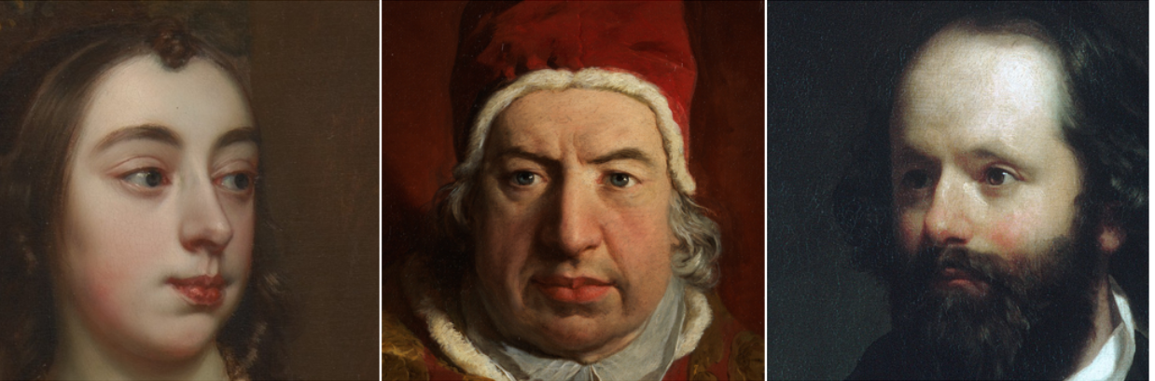
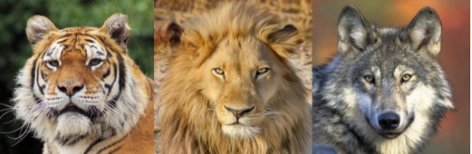
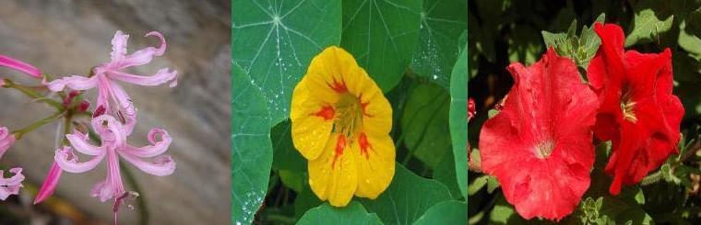
Experimental Setup
DATASETS and Architecture
Dataset | No. of images
METFACES | 1,336
Animal-Faces-High-Quality (AFHQ) | WILD: 4,738 DOG: 4,739
Cars196 | 16,185
OxfordFlowers102 | 6,149
Architecture
The StyleGAN2-ADA mechanism is implemented on top of the StyleGAN2 ofﬁcial TensorFlow implementation with most of the details unchanged, including network architectures.

Slide 5
Experimental Setup
Preprocessing
Resizing
We resize our dataset to half the original size that was used in the paper, that is, a resized resolution of (256 X 256) for all datasets except for the METFACES dataset, which we resized to (512 X 512).
Data Augmentation
The ADA mechanism mitigates issues related to the overfitting of the discriminator and undesirable distortions associated with StyleGAN2.
These augmentations consist of 18 transformations: geometric (7), color (5), filtering (4), and corruption (2).

Slide 6
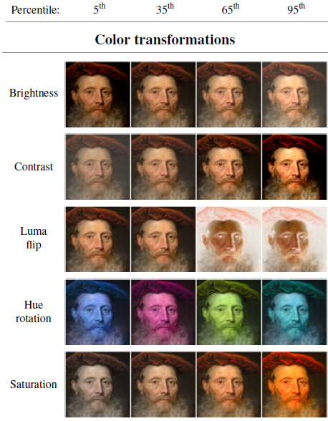
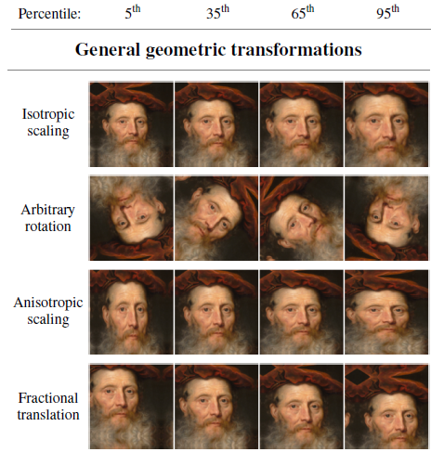
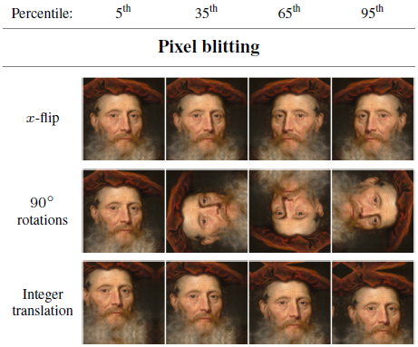
Experimental Setup
Data Augmentation Pipeline
Geometric and color transformations
Pixel Blitting
General geometric transformations
Color transformations

Slide 7
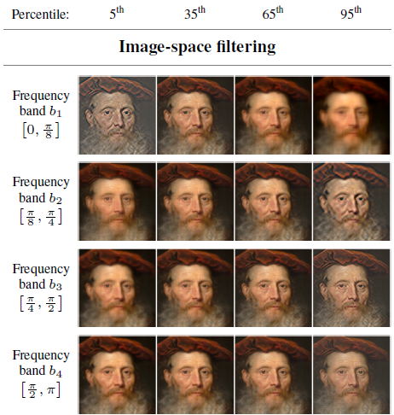
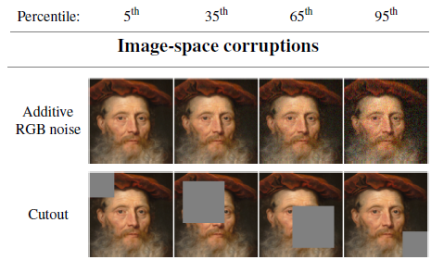
Experimental Setup
Data Augmentation Pipeline
2. Image-space filtering and corruptions
Image-space filtering
Image-space corruptions

Slide 8
Experimental Setup
Hyperparameters & Evaluation
Parameter | METFACES | AFHQ-WILD | AFHQ-DOG | Cars196 | Oxford Flowers102
Resolution | 512*512 | 256*256
No. of GPUs (Tesla V100) | 2
Base feature maps | 16,384 | 8,192 | 5,000 | 16,185 | 8,192
Training time (hrs) | 92.05 | 132.64 | 93.22 | 146.46 | 120.84
Minibatch size | 16 | 32
Minibatch stddev | 4 | 4 | 16 | 16 | 4
Learning rate | 0.0025
R1 regularization | 3.2768 | 0.4096
Dataset x-flips; Mixed-precision; Mapping net depth; Style mixing reg.; Path length reg.; Resnet D | Yes | Yes | Yes | Yes | Yes
Evaluation
We used FID metric to evaluate our results, and compare it to the FID scores obtained from the original paper.

Slide 9
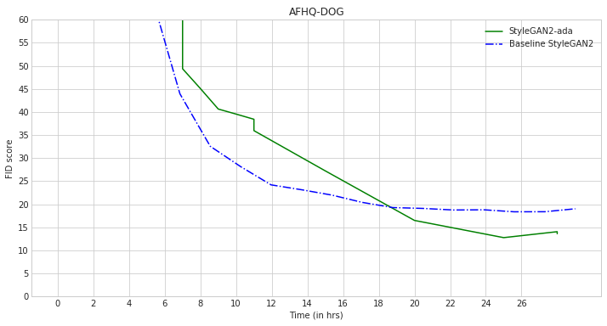
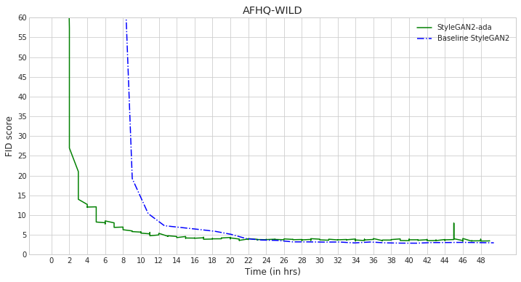
Current Result
Comparison with baseline StyleGAN2
FID score as a function of wallclock time. Each curve corresponds to training the dataset from scratch with two NVIDIA Tesla V100 GPUs.

Slide 10
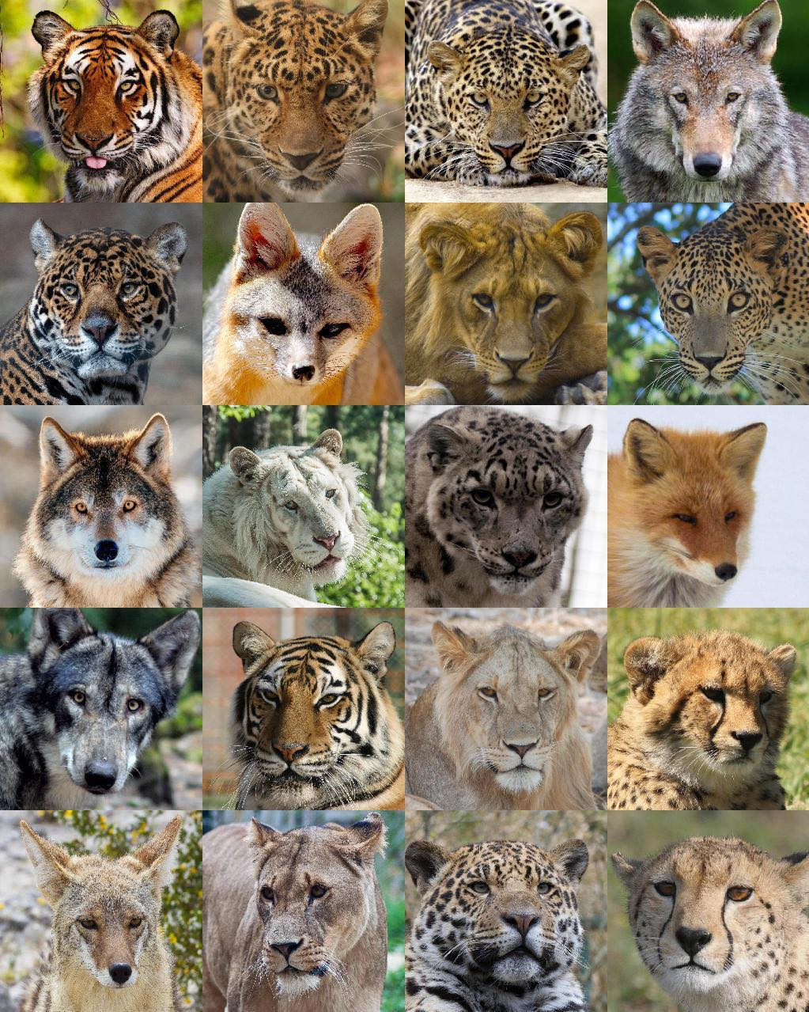
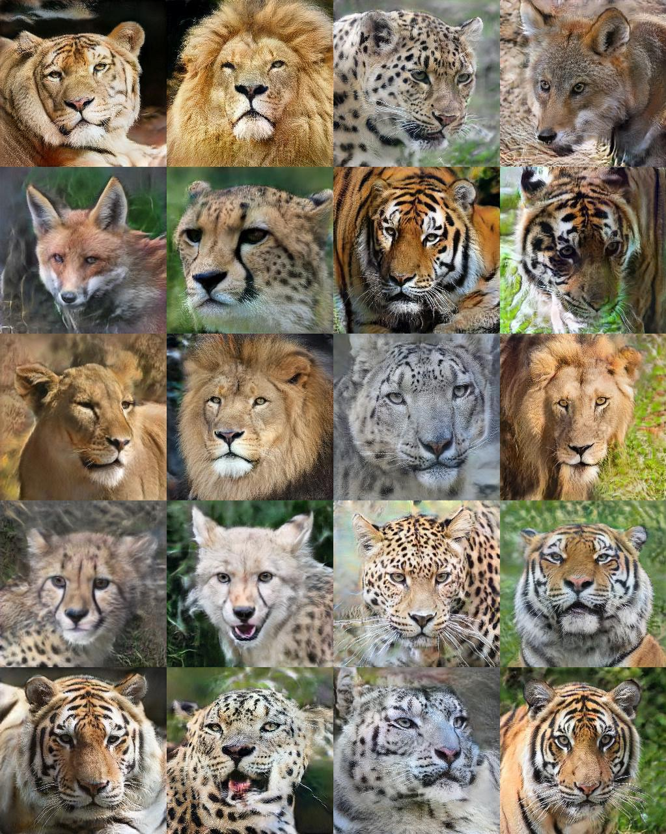
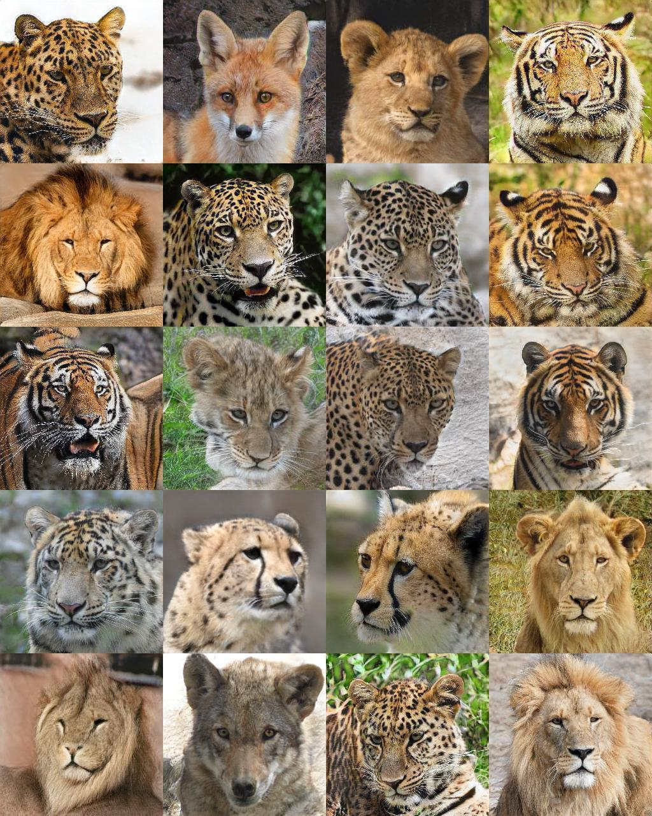
Current Result
Comparison with baseline StyleGAN2
Real images from the training set
Original baseline StyleGAN2
StyleGAN2-ADA
Uncurated 256×256 results generated for AFHQ-WILD (4738 images) with and without ADA, along with real images from the training set. Both generators were trained from scratch for 50 hours.

Slide 11
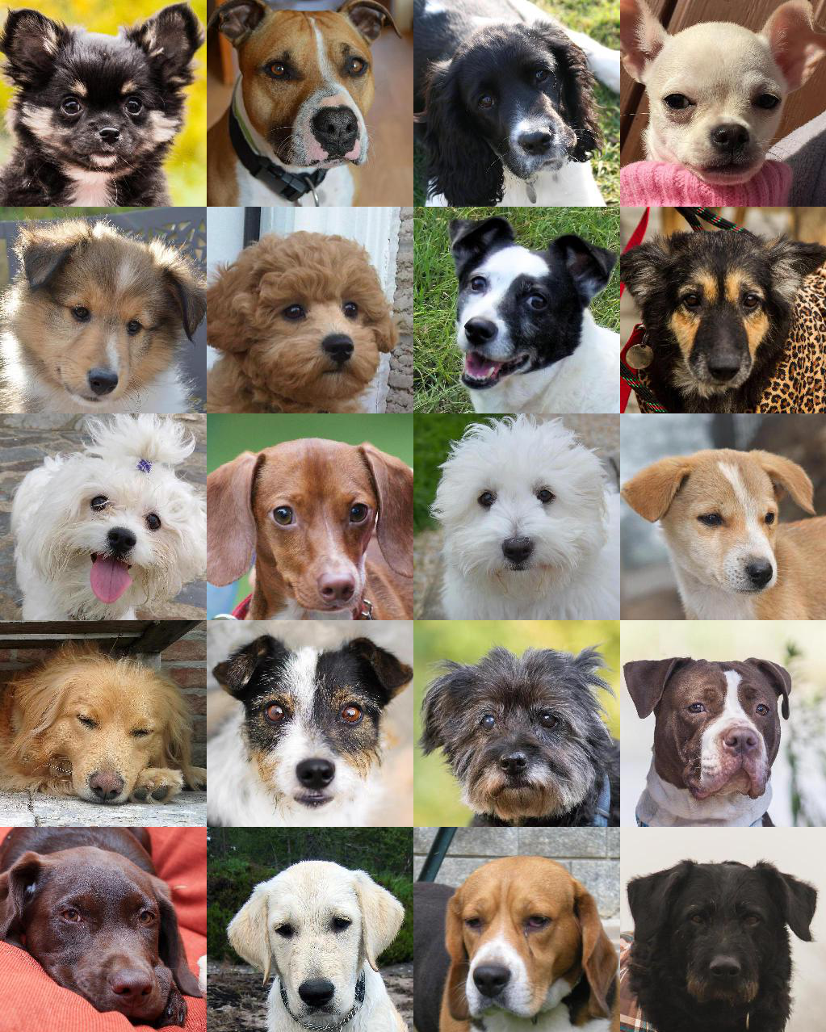
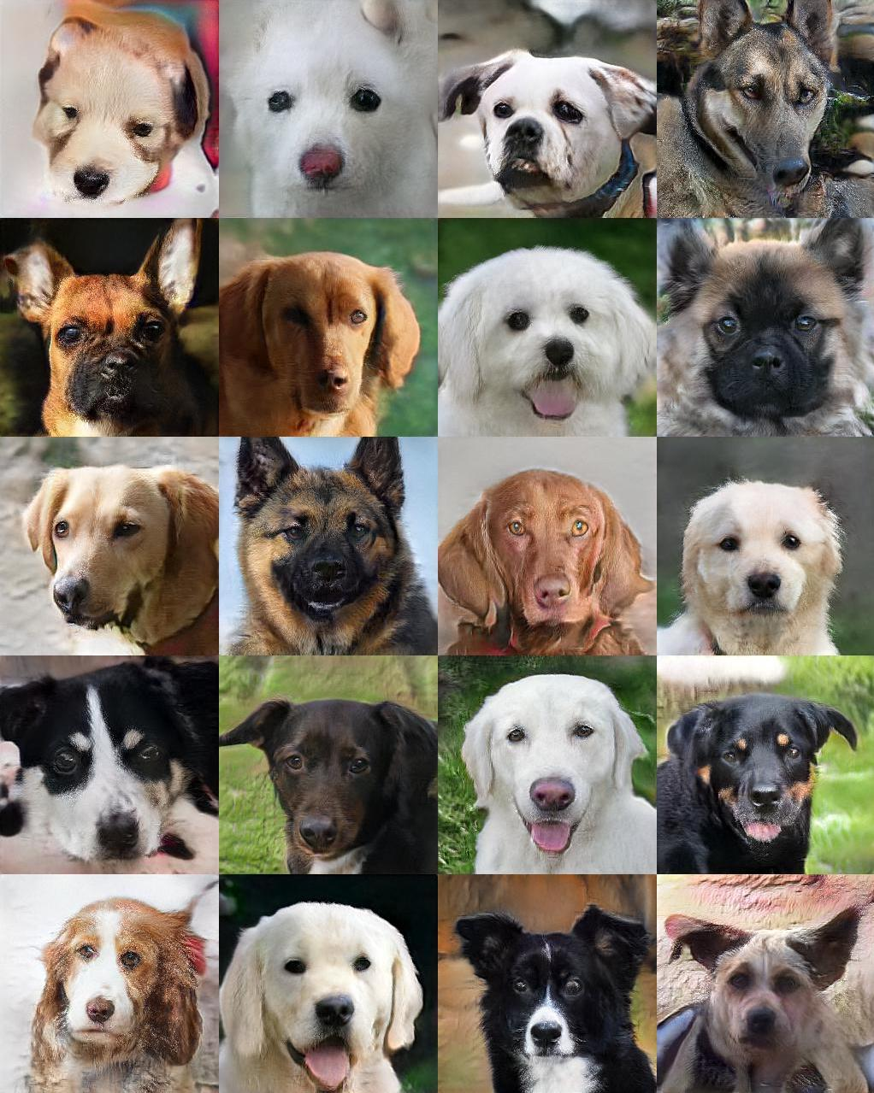
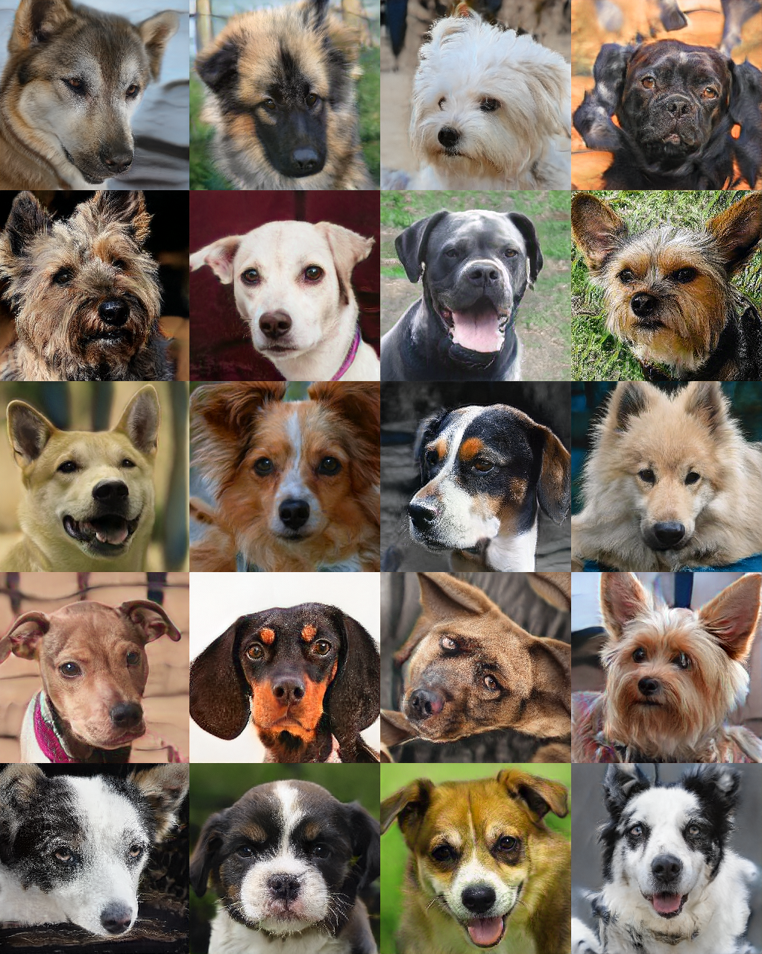
Current Result
Comparison with baseline StyleGAN2
Real images from the training set
Original baseline StyleGAN2
StyleGAN2-ADA
Uncurated 256×256 results generated for AFHQ-DOG (4739 images) with and without ADA, along with real images from the training set. Both generators were trained from scratch for 28 hours.

Slide 12
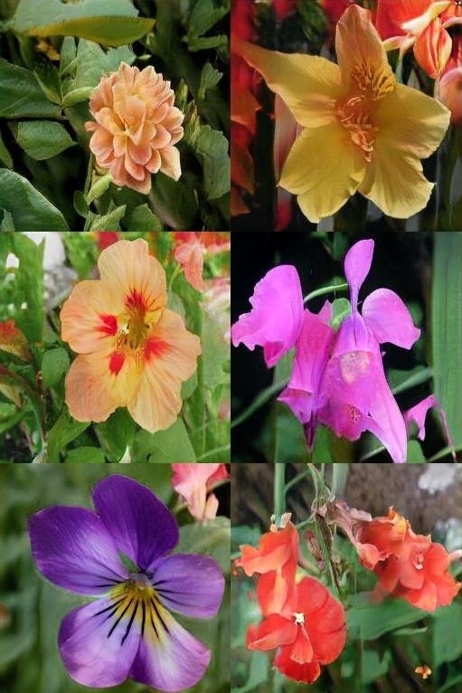
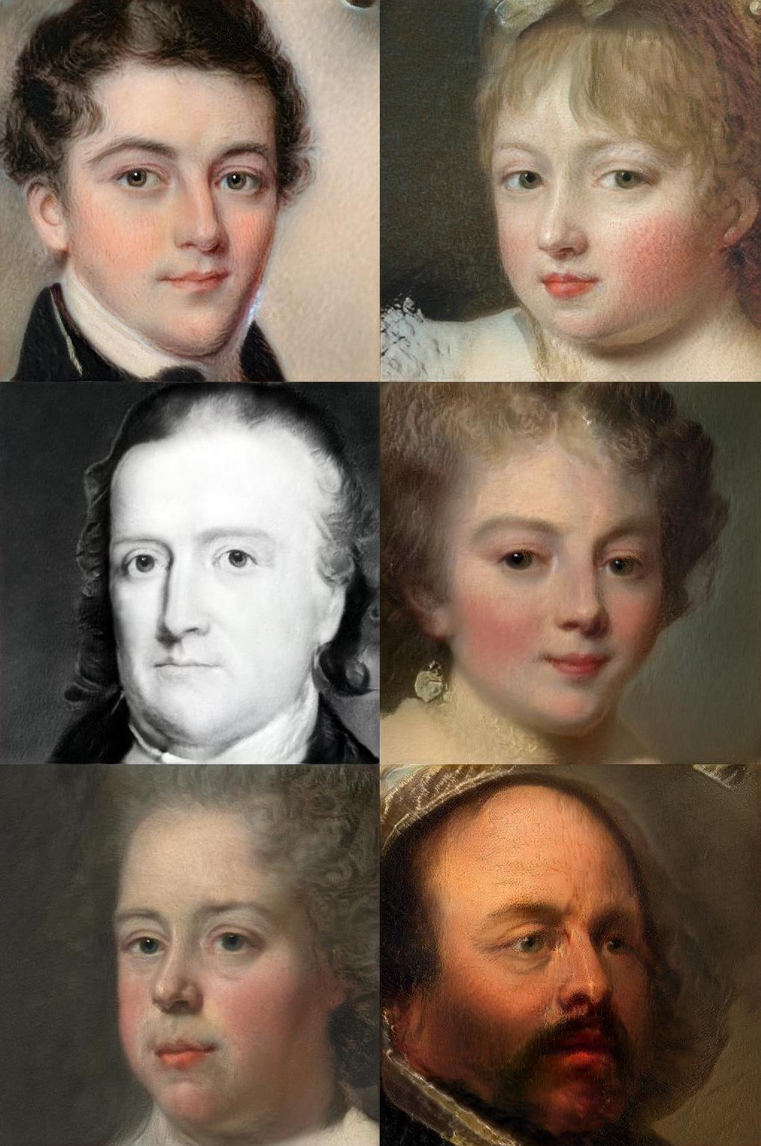
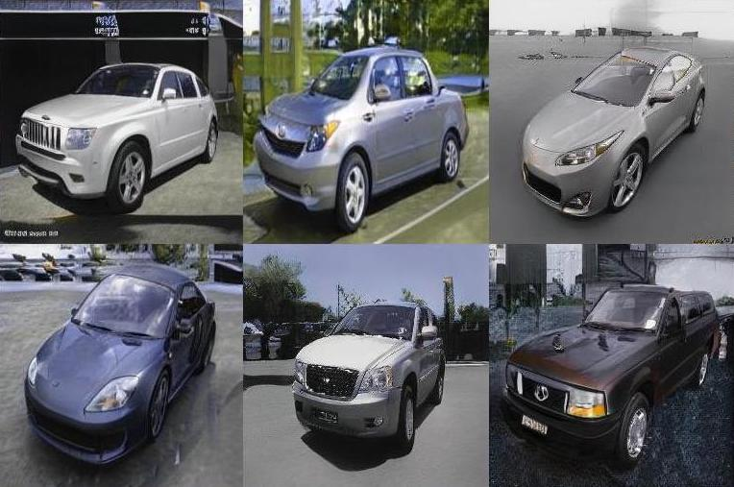
Current Result
Fréchet inception distance (FID) Scores
Dataset | Training Time (in hrs) | Current FID (ADA-StyleGAN2) | Reported FID
METFACES | 102 | 20.89 | 18.22 (Original paper)
AFHQ-WILD | 132 | 2.23 | 3.05 (Original paper)
AFHQ-DOG | 93 | 10.83 | 7.40 (Original paper)
Cars196 | 146 | 9.21 | 16.03 (FineGAN)
OxfordFlowers102 | 120 | 7.53 | 19.60 (MSG-StyleGAN)

Slide 13
Discussion
Model performance:
~1.8x faster training.
Reaches convergence in a relatively short time.
Reasonable out-of-the-box results for different dataset resolutions and few GPUs.
The ADA mechanism improve results
Next step:
Train subsets of the datasets with StyleGAN2-ada and compare performance.

Slide 14
Thanks for Listening!
Any questions?

